Slide 1
Introduction to Cybersecurity

Slide 2
What is Cybersecurity?
Cybersecurity and Infrastructure Security Agency (CISA) defines Cybersecurity as the art of protecting networks, devices, and data from unauthorized access or criminal use and the practice of ensuring confidentiality, integrity, and availability of information.
Notes:
What does that mean? Well As we use computers and the internet more and more in our personal lives and our professional lives, the opportunities for hackers to illegally exploit our information increases. Here's a question to think about: How much of your daily life relies on technology, do you communicate through emails, our messages through your phone, do you online shop, do you use social media, A lot of our personal information these days are stored in a digital format,for example our medical records are most likely in an online database, and that's why cybersecurity is so important, not only does it protect our data but it also prevents cyber attacks by using different mitigation methods and security protocols.

Slide 3
There are five key principles in Cybersecurity:
Confidentiality
Integrity
Availability
Accountability
Auditability

Slide 4
Five key principles in Cybersecurity:
Confidentiality:
A set of rules that limits access or place restrictions on a certain type of information.
Integrity:
Assurance that the information is trustworthy and accurate.
Availability:
The guarantee of reliable access to the information by authorized people.

Slide 5
Five key principles in Cybersecurity:
Accountability:
Is an assurance that an individual or an organization will be evaluated on their performance or behaviour related to something for which they are responsible.
Auditability:
A security audit is a systematic evaluation of the security of a company’s information system by measuring how well it conforms to a set of established criteria.

Slide 6
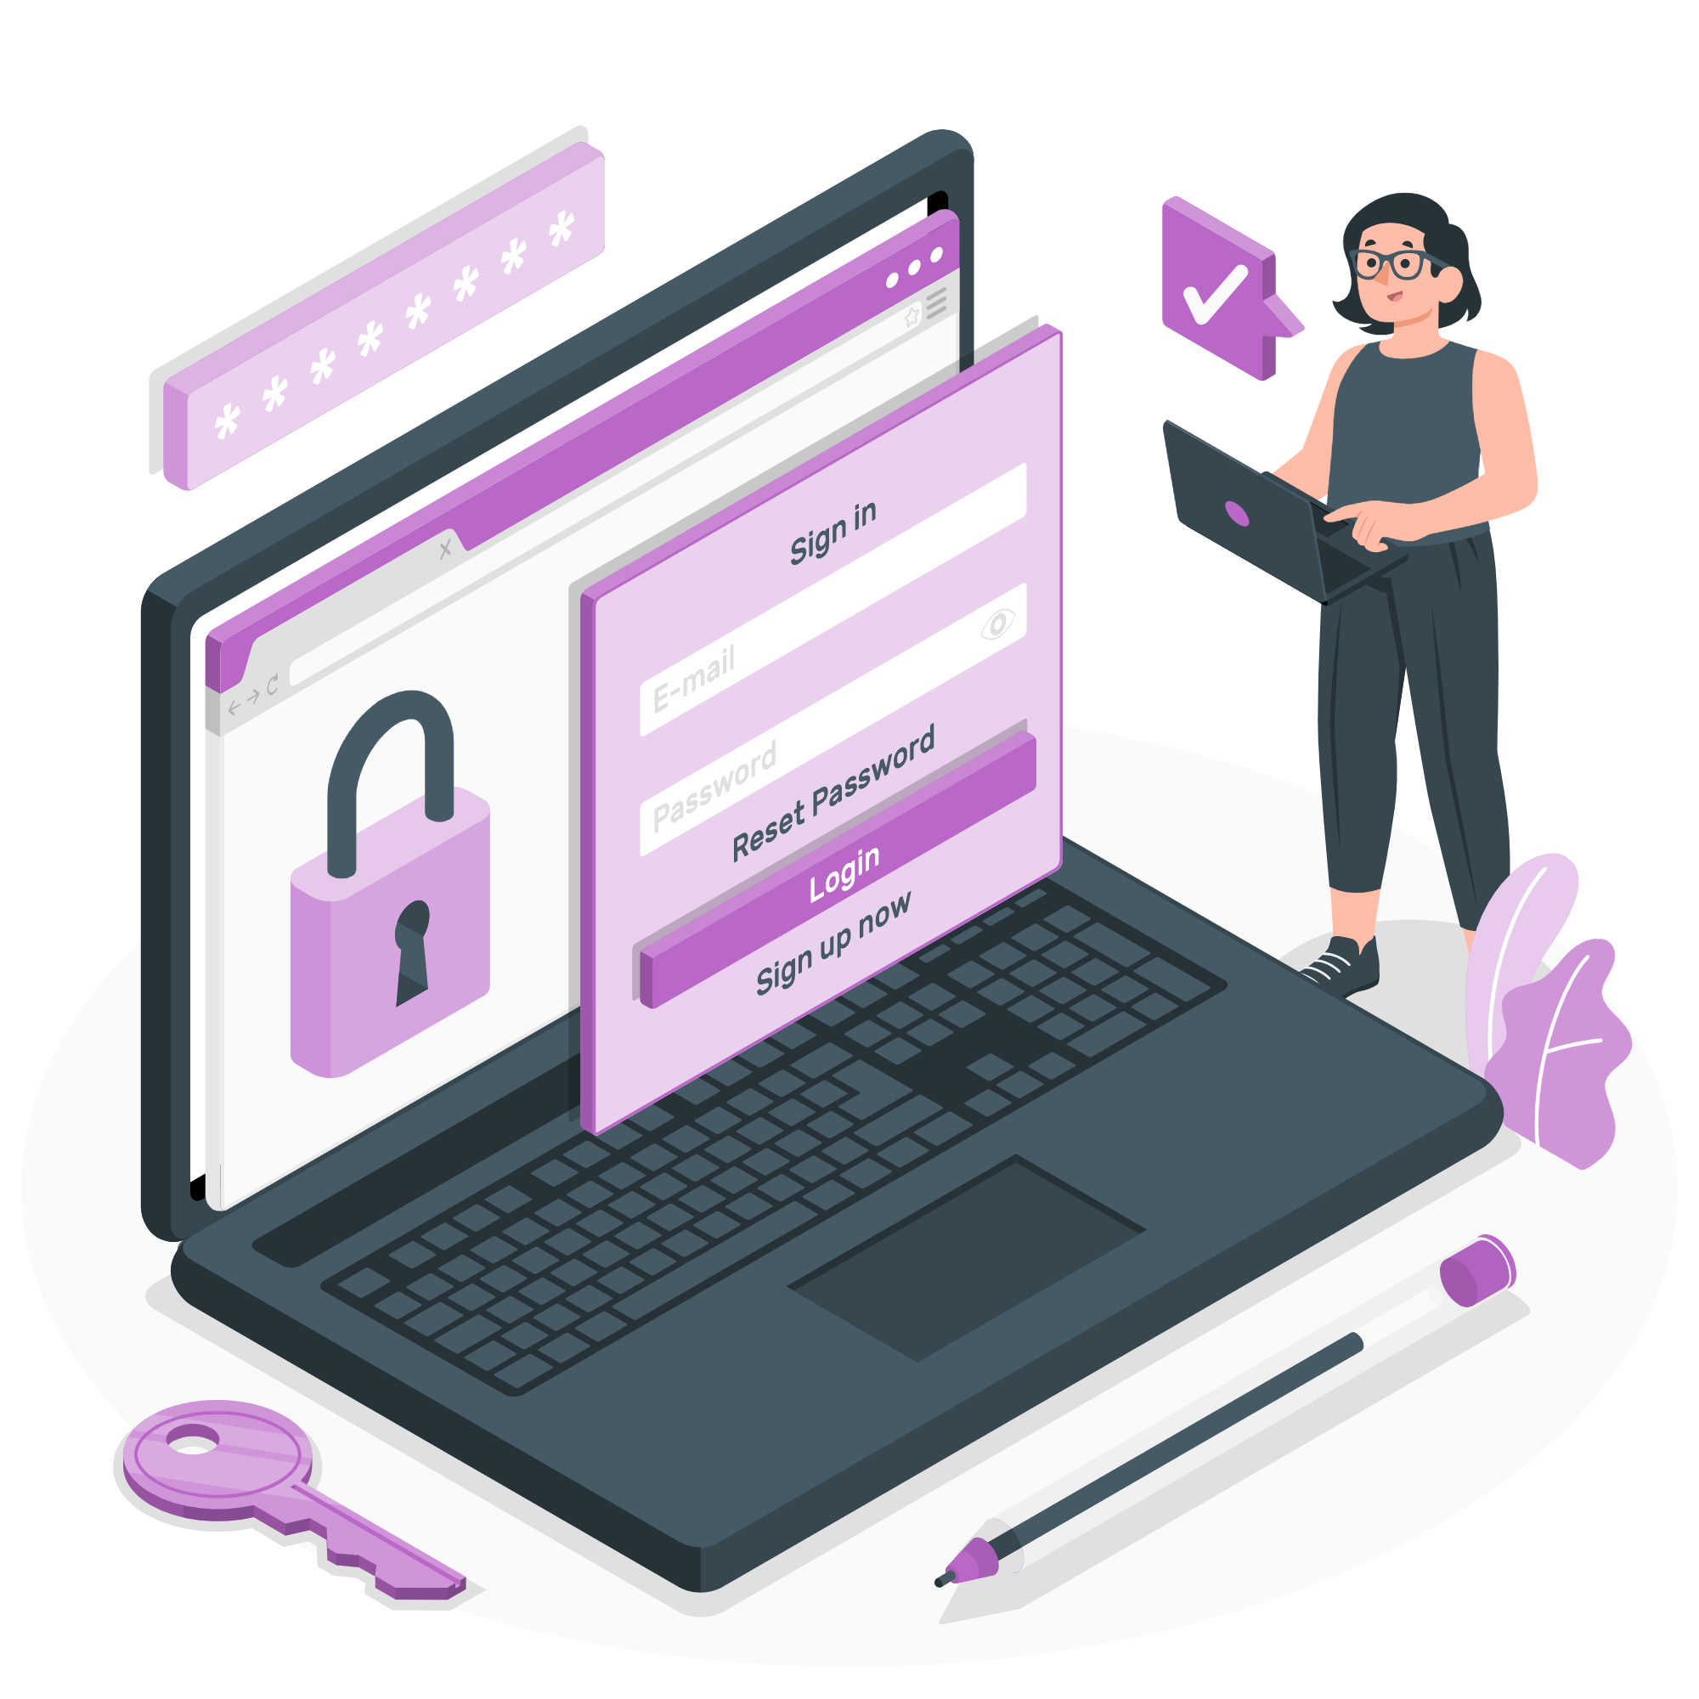
Most Common Type of Attacks

Slide 7

Malware Attacks
Phishing Attacks
Man-in-the-Middle Attack
Denial-of-Service Attack
Notes:
This is one of the most common types of cyberattacks. “Malware” refers to malicious software viruses including worms, spyware, ransomware, adware, and trojans.
Phishing attacks are one of the most prominent widespread types of cyberattacks. It is a type of social engineering attack wherein an attacker impersonates to be a trusted contact and sends the victim fake mails.
A Man-in-the-Middle Attack (MITM) is also known as an eavesdropping attack. In this attack, an attacker comes in between a two-party communication, i.e., the attacker hijacks the session between a client and host. By doing so, hackers steal and manipulate data.
A Denial-of-Service Attack is a significant threat to companies. Here, attackers target systems, servers, or networks and flood them with traffic to exhaust their resources and bandwidth.

Slide 8
What can you do to improve your Cybersecurity?
Keep software up to date
Use strong passwords
Be suspicious of unexpected emails.
Notes:
Install software patches so that attackers cannot take advantage of known problems or vulnerabilities. Many operating systems offer automatic updates. If this option is available, you should enable it.
Select passwords that will be difficult for attackers to guess, and use different passwords for different programs and devices. It is best to use long, strong passphrases or passwords that consist of at least 16 characters.
Phishing emails are currently one of the most prevalent risks to the average user. The goal of a phishing email is to gain information about you, steal money from you, or install malware on your device. Be suspicious of all unexpected emails.

Slide 9
Thank You!

